Slide 1
AN INVESTIGATIONAL STUDY INTO THE DESIGN OF A LOW COST, ADAPTIVE HEARING AID
Presented by:
Kayla-Jade Butkow (714227)
Kelvin da Silva (835842)

Slide 2
Overview

Slide 3
Objectives and Specifications

Slide 4
System Block Diagram

Slide 5
Simulated vs Hardware Hearing Aid
Property | Simulation | Hardware
Number of microphones | 10 | 4
Device Bandwidth | 0.25–8 kHz | 2.8-3.5 kHz and 5.6-7 kHz
Filter Order | 14 | 2
Filter Bandwidth | 1/3 Octave | 1/3 Octave
Types of filters | Butterworth FIR bandpass | Butterworth bandpass
Number of filters | 16 per microphone | 2 per microphone
Number of steerable angles | 19 (10° increments) | 5 (0°, 60°, 90°, 120°, 180°)
Real time data acquisition | No | Yes

Slide 6
Compensatory Amplification

Slide 7
Directionality
Amplification in a user specified direction
Delay-and-sum beamforming

Slide 8
Cost Breakdown
Component | Cost (R)
Arduino Due | 569.00
MAX9814 Microphone Amplifier x4 | 546.00
LM358 x5 | 16.05
LM386 | 15.75
Headphone Jack | 16.31
9V Battery | 70.00
Veroboard | 49.70
Headphones | 69.90
Casing | 59.90
Miscellanous | 50.00
Total | 1462.61

Slide 9
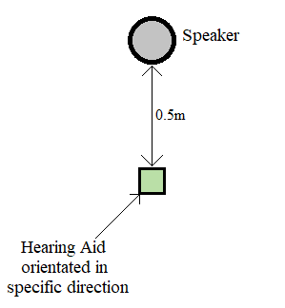
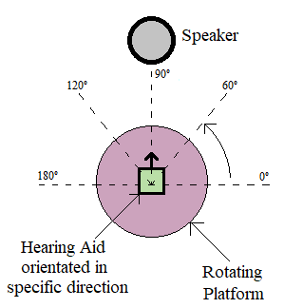
Testing
Compensatory gain
Directionality

Slide 10
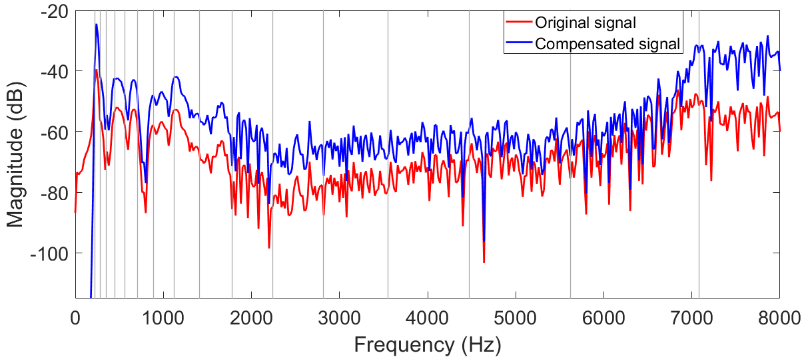
Results: Simulation

Slide 11
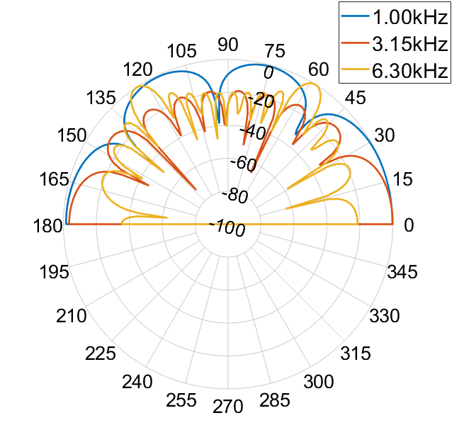
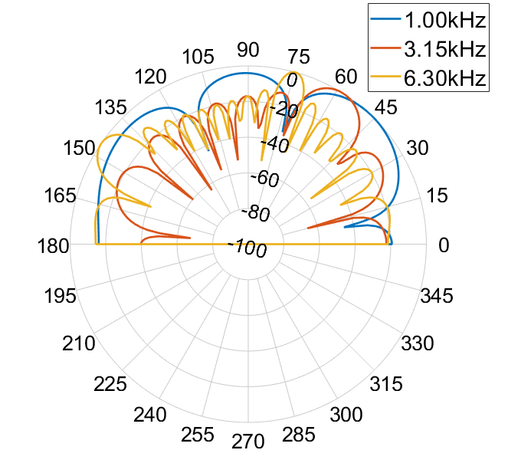
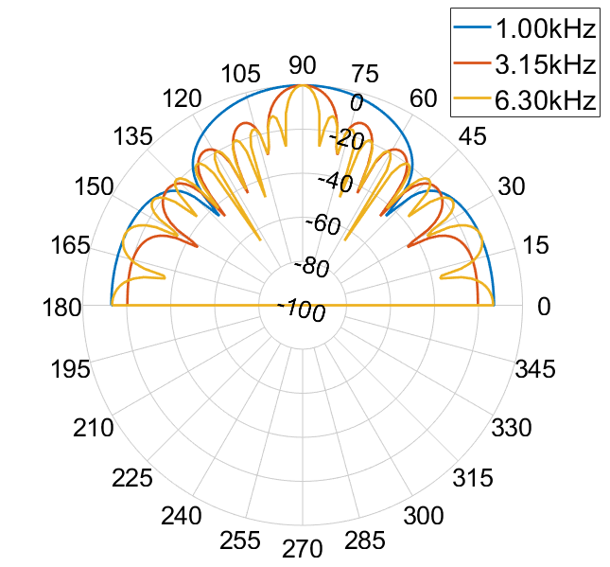
Results: Simulation
0°
60°
90°

Slide 12
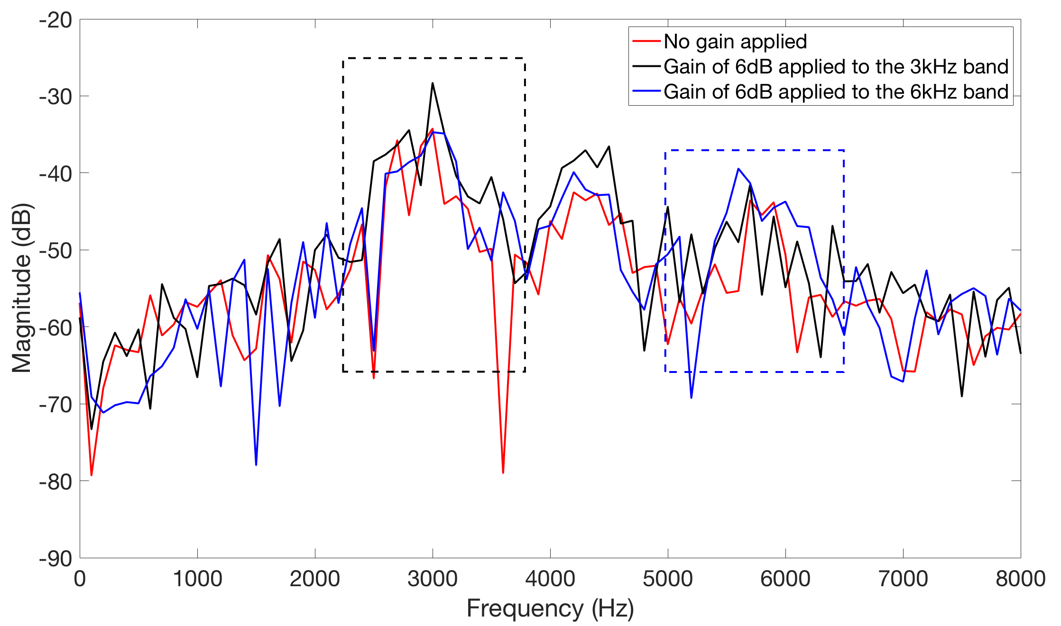
Results: Hardware

Slide 13
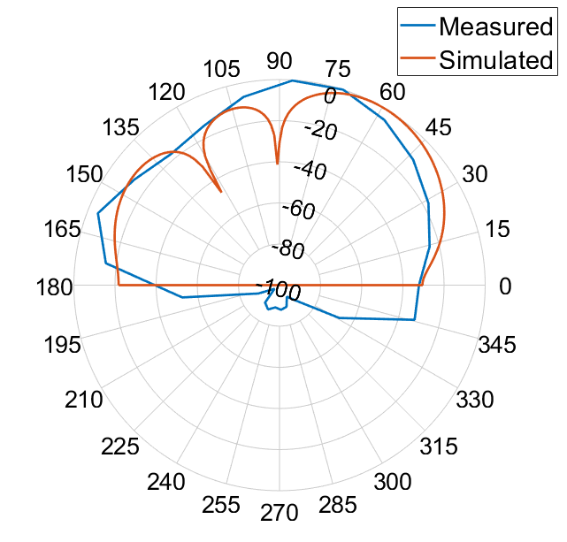
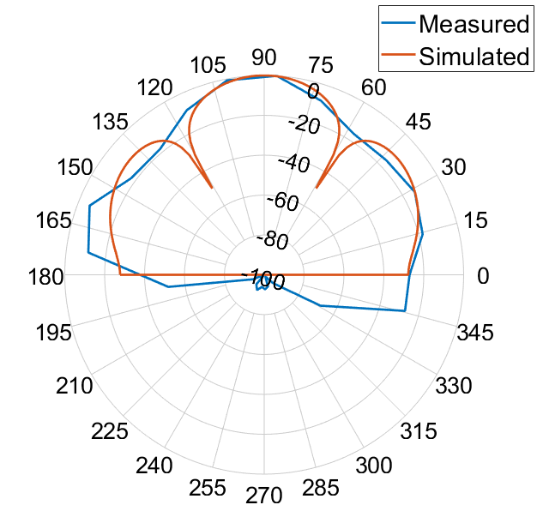
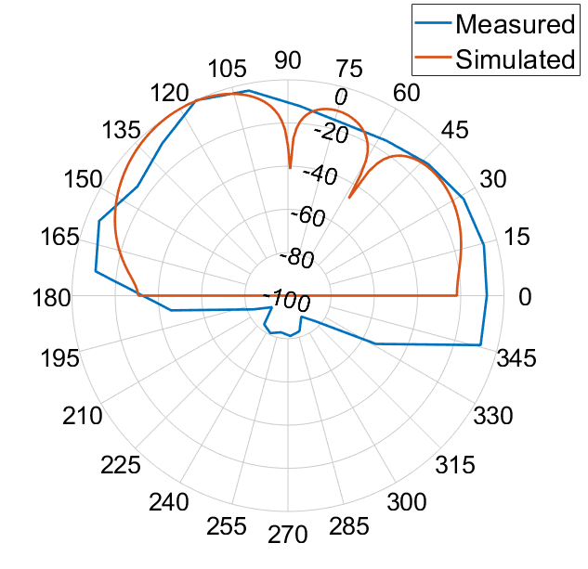
Results: Hardware
60°
90°
120°

Slide 14
Future Work

Slide 15
Conclusion

